Slide 1
Csc 310
CONCURRENT PROGRAMMING

Slide 2
GROUP 3
OLORUNFEMI-OJO TOMIWA 190805503
MUMUNI ABDULLAH 180805047
SANUSI ADEYEMI 180805050

Slide 3
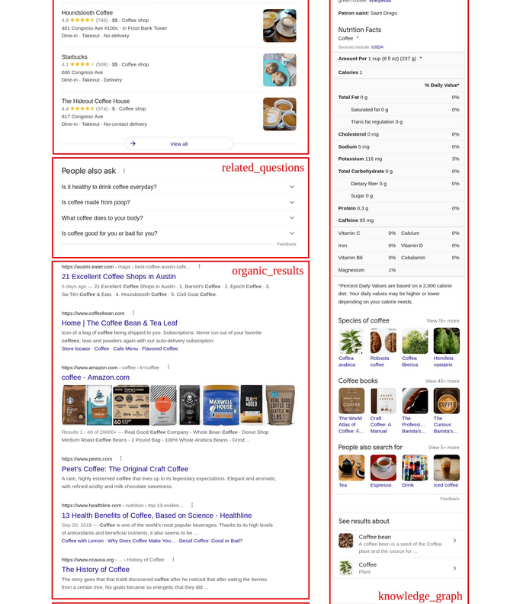
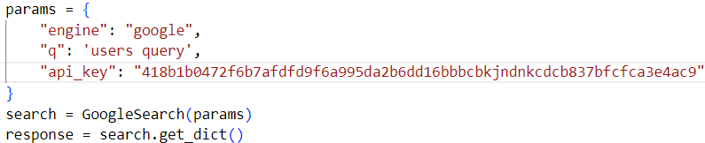
Search engine results pages: fetching organic results
https://github.com/serpapi/google-search-results-python

Slide 4
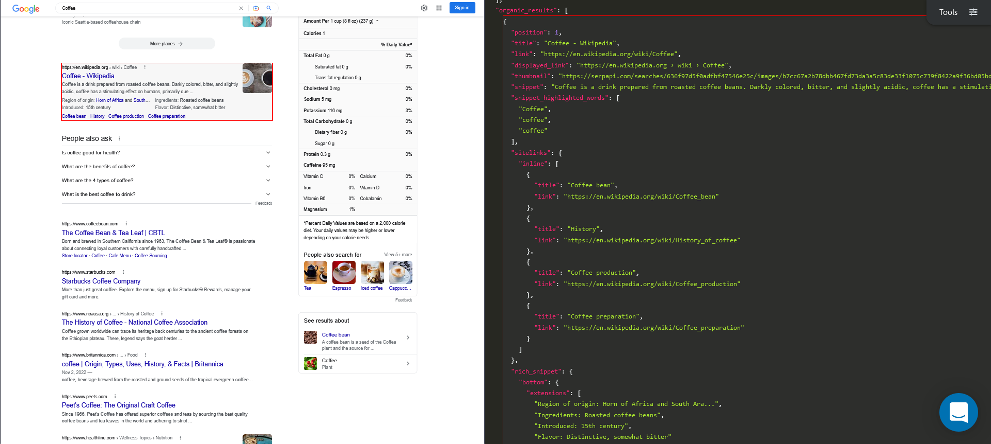
Search engine results pages: fetching organic results
https://github.com/serpapi/google-search-results-python

Slide 5
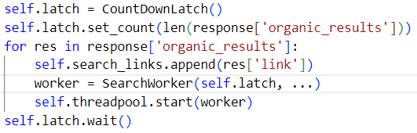
Search engine results pages
Create a countdown latch.
For every link in the organic response, open the link on a new thread and decrement the latch.
Wait for the latch to reach 0 before continuing processing.

Slide 6
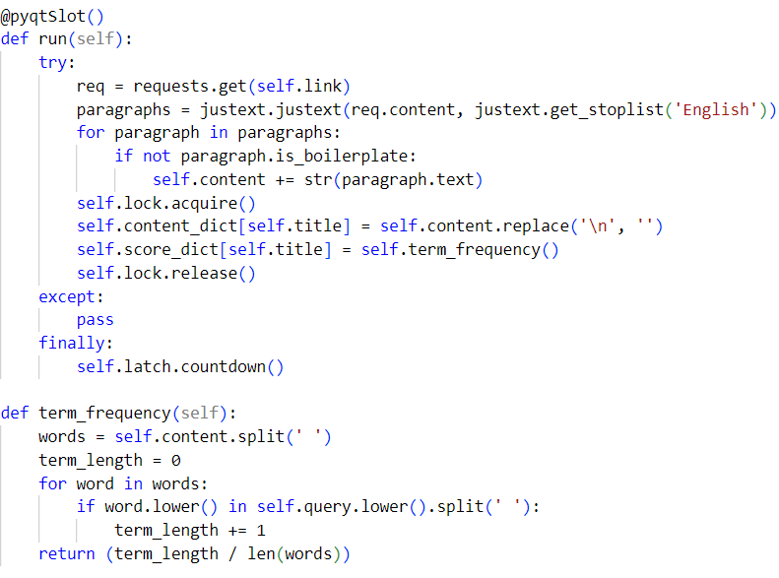
Search engine results pages: what goes on in the thread
Fetch the html in the page
Extract the main content in the page
Acquire a lock to save the content to a not thread safe data structure.
Calculate the term frequency and save to a not thread safe data structure.
Release the lock and decrease the latch

Slide 7
Search engine results pages
When the countdown latch reaches zero
Select the top 5 content
Display the top 5 content
Visualize the top 5 content based on relevancy

Slide 8
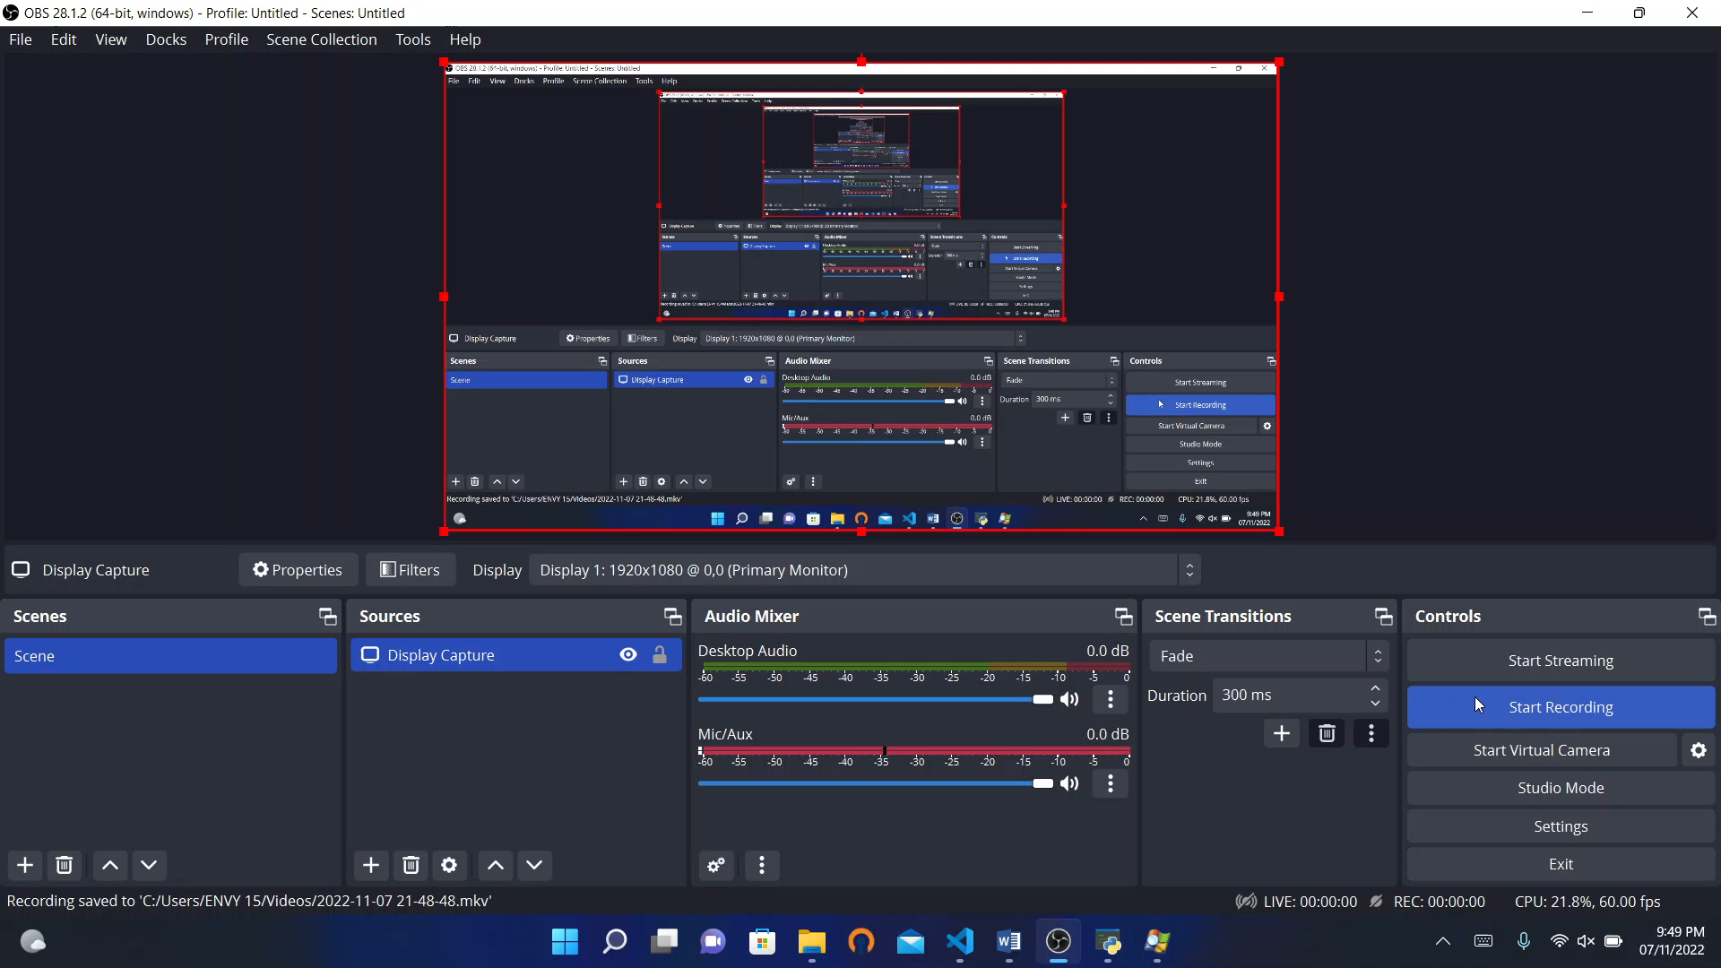
Search engine results pages: video dEMO (SHOWIng live thread creation)

Slide 9
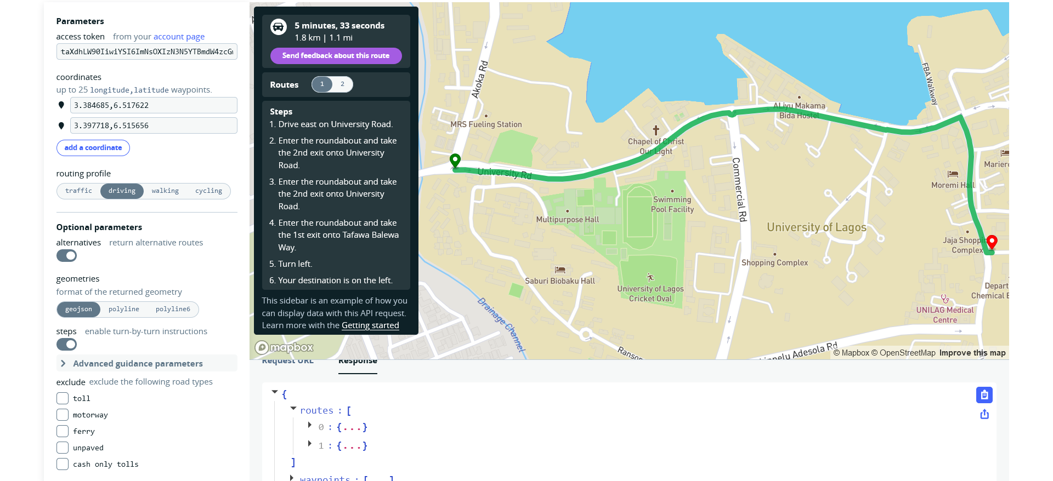
Tracking vehicle fleet: Fetch routes using mapbox directions api
Fetch all possible routes
Display map
Mark the start and stop positions
Place vehicles at the start positions

Slide 10
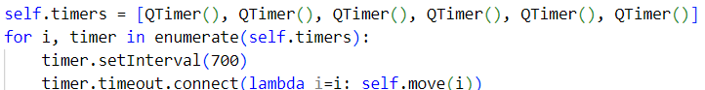
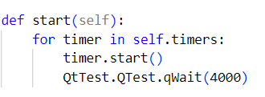
Tracking vehicle fleet
Movement of each vehicle is controlled by a timer. Vehicle moves every 700 milliseconds
On clicking the start button, start each timer after a 4 seconds interval.

Slide 11
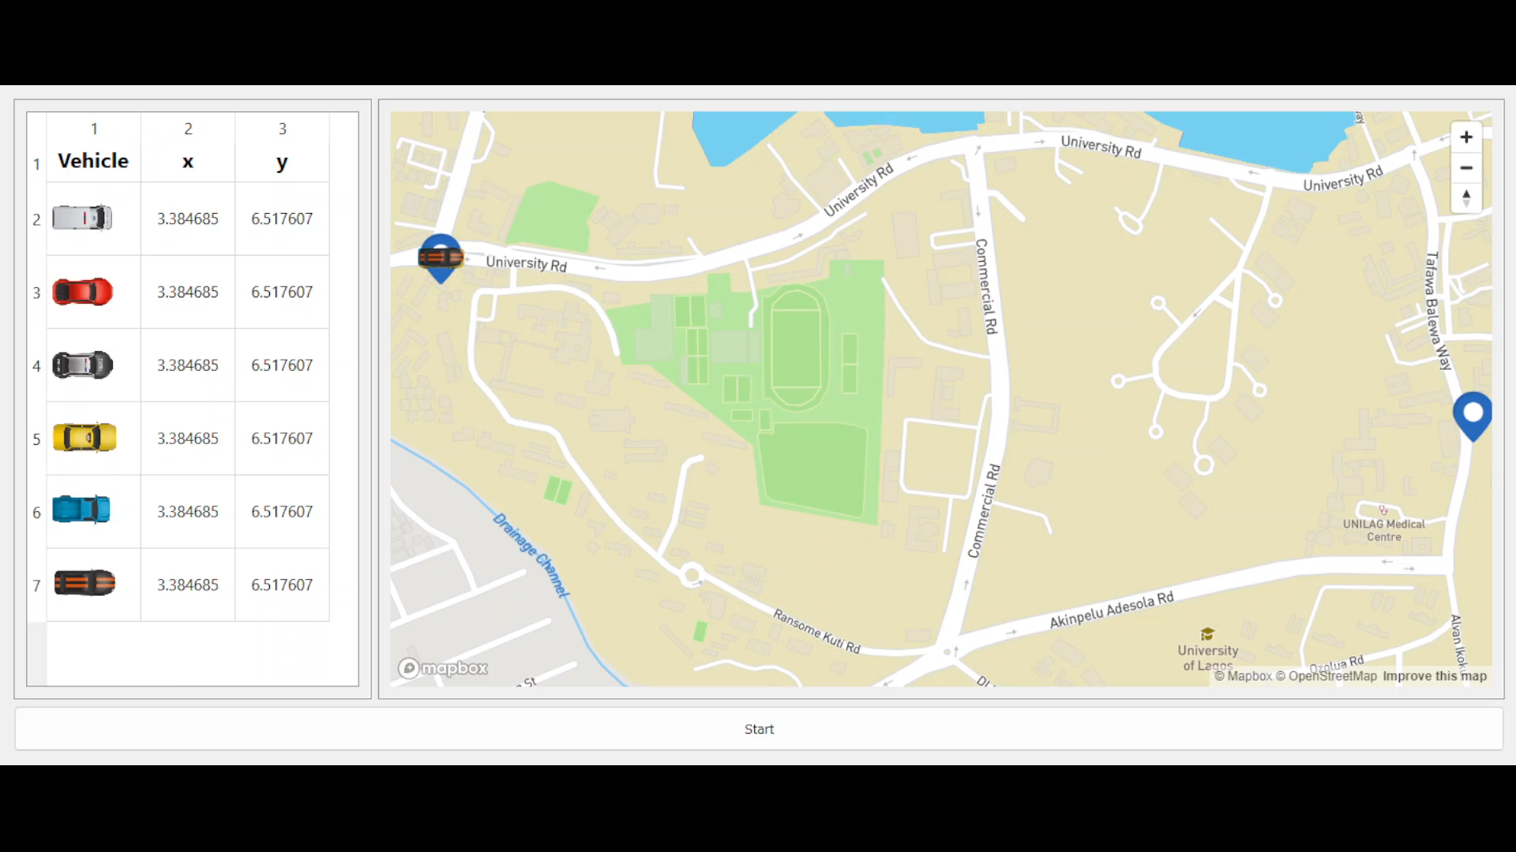
Tracking vehicle fleet: video demo

